Slide 1
Lecture 32: Ethics

Slide 2
Data Driven Decisions
Notes:
Anyone feel like they are not included in these results?
While this does include one woman of color (plus a child in costume and a puppet), the picture of the woman of color is her arrest photo after hitting her granddaughter with a slipper (Florida, gotta love it!)

Slide 3
Data Driven Decisions
Notes:
Are these results ETHICAL? There are two pictures of women – one of which is historical.

Slide 4

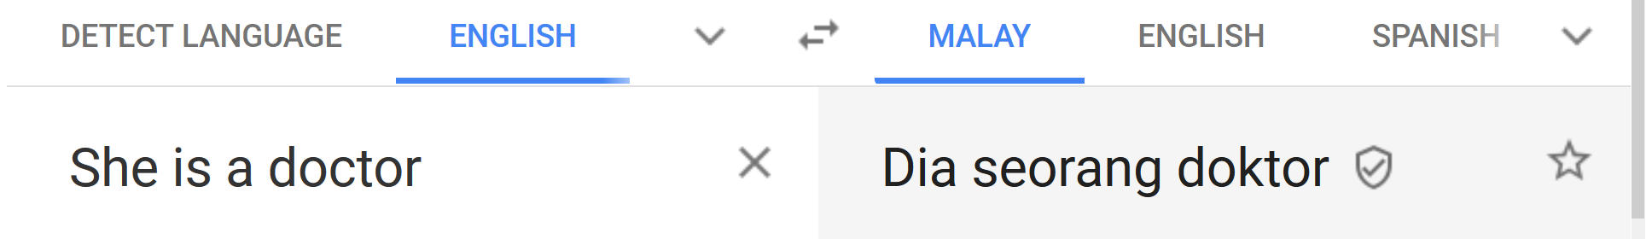
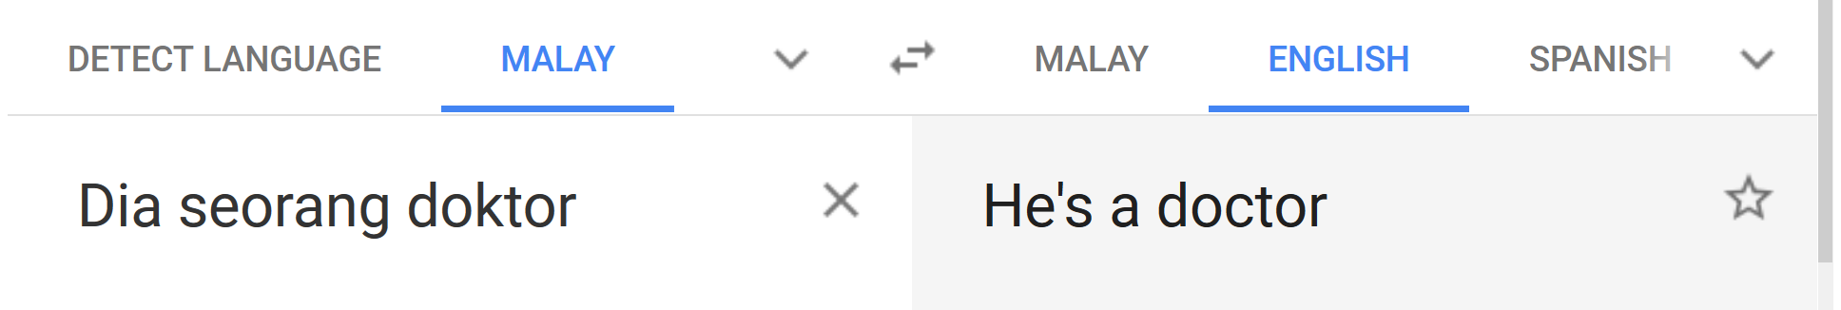
What is the Impact?
Notes:
The Malay language is not gendered, so "Dia seorang doktor" could refer to a man or a woman. Google translate does not note this, however
Credit for finding this goes to Dakota Handzlik

Slide 5
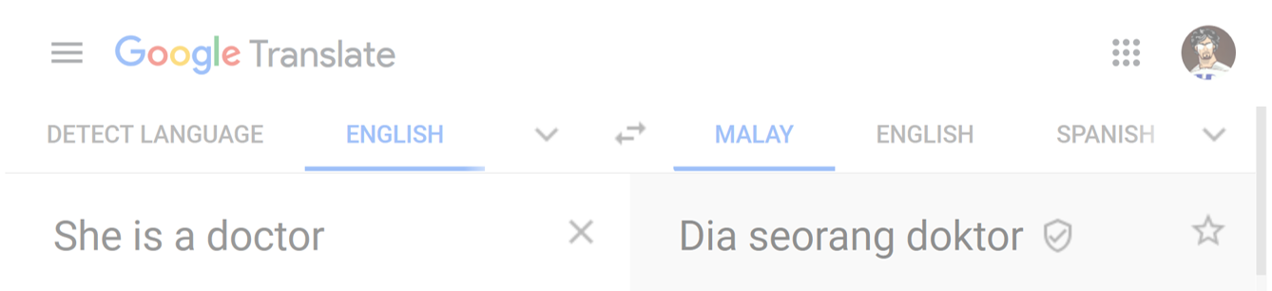
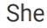
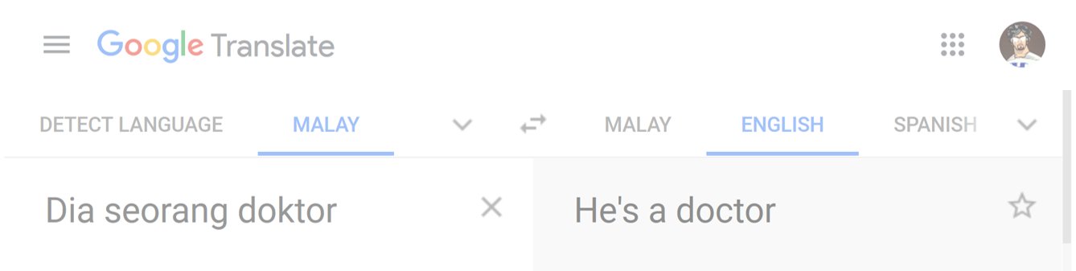
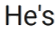
What is the Impact?
Notes:
The Malay language is not gendered, so "Dia seorang doktor" could refer to a man or a woman. Google translate does not note this, however
Credit for finding this goes to Dakota Handzlik

Slide 6
What is the Impact?
Notes:
News story retrieved from https://www.wired.com/story/web-accessibility-blind-users-dominos/ on Nov. 18, 2019. Used under fair use exemption to copyright law

Slide 7
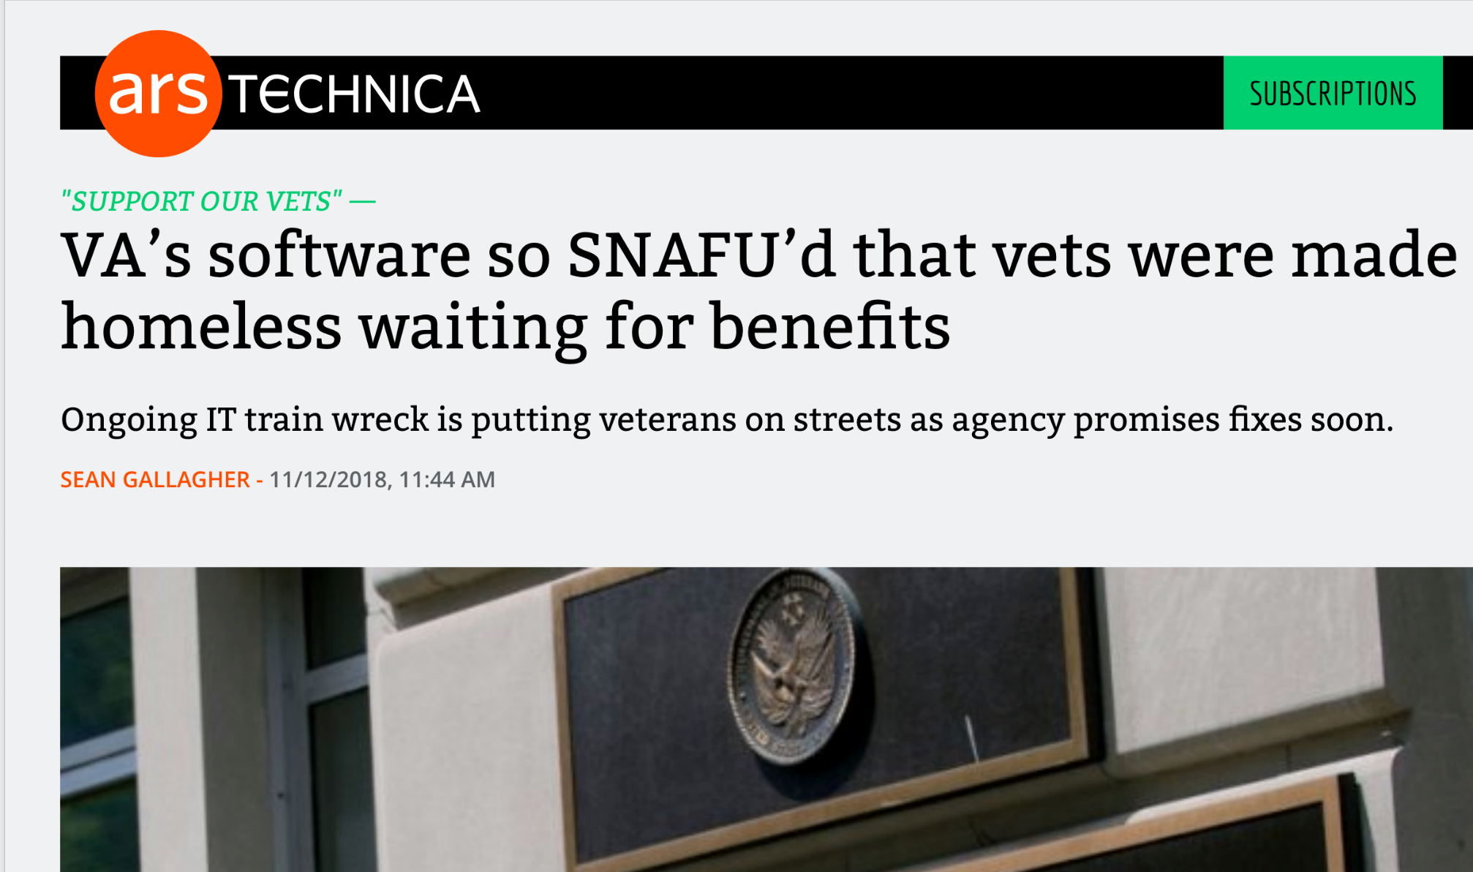
Non-"Big Data" Issues

Slide 8
Non-"Big Data" Issues
Notes:
Headline retrieved from https://www.computerworld.com/article/3406846/wtf-microsoft.html

